Slide 1

Loan Approval Likelihood
Team Members: Desiree Diaz, Medina Izgutdina,
Irene Okada, Wei Zhu

Slide 2
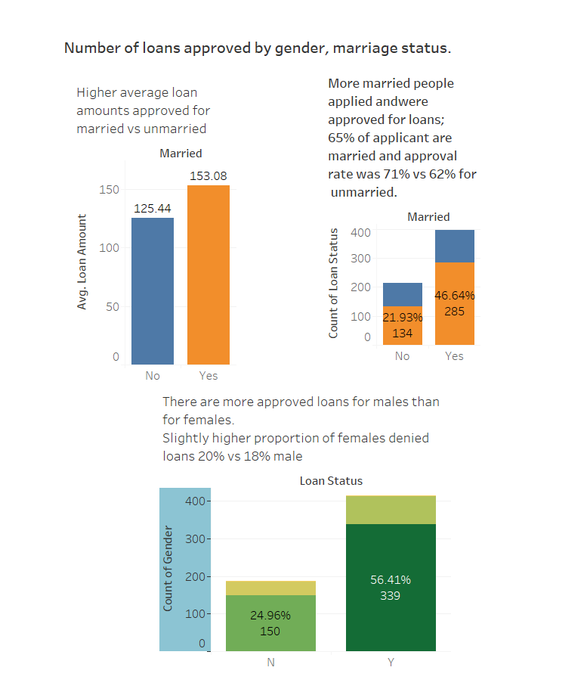
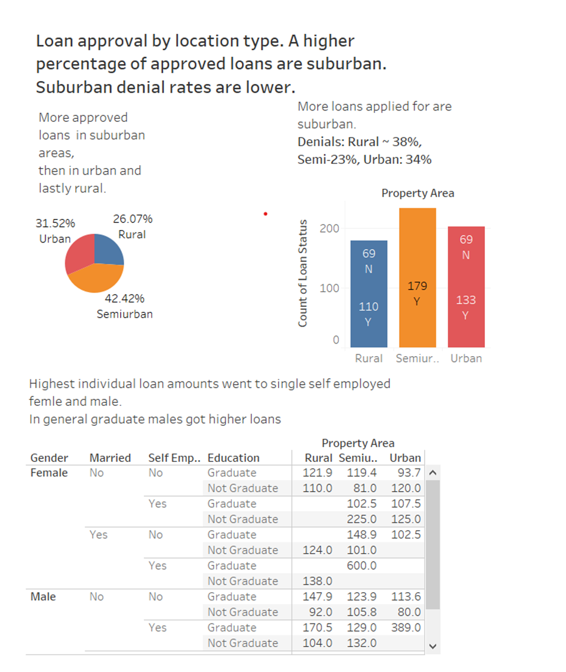

Slide 3
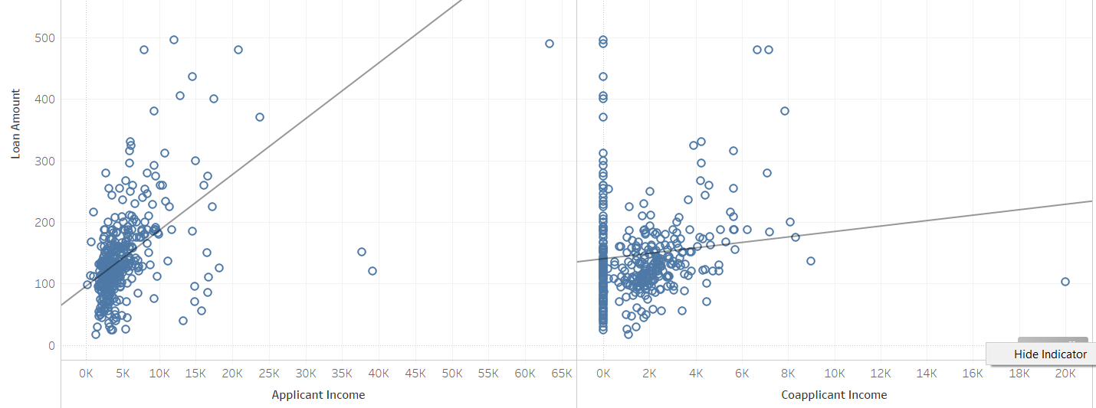
Income vs Loan amount https://public.tableau.com/profile/ireneokada

Slide 4
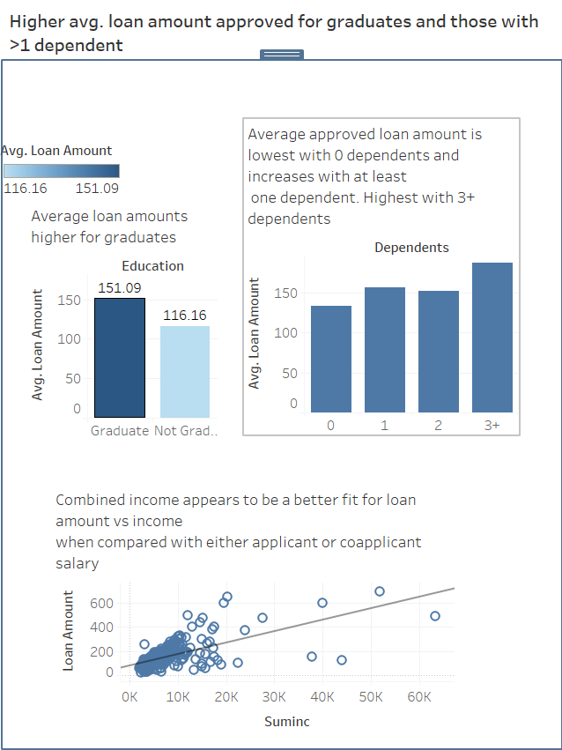
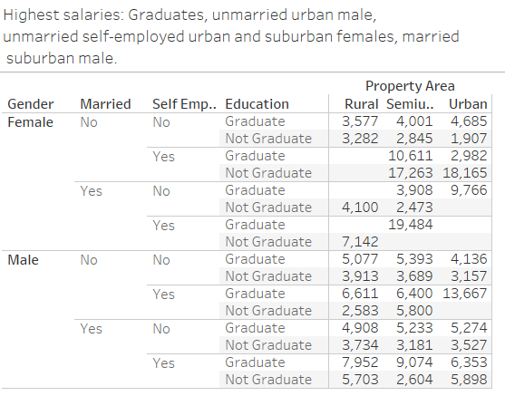

Slide 5
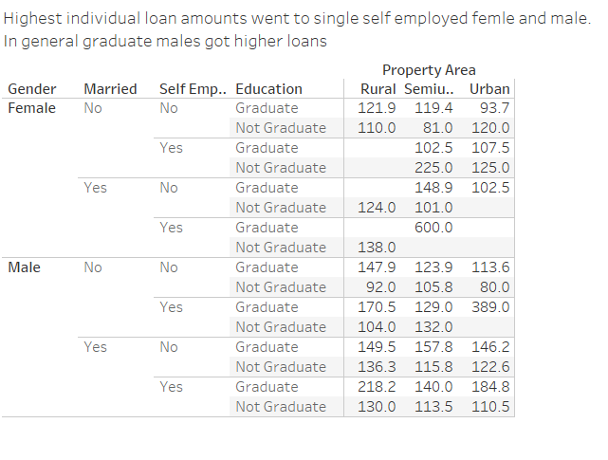


Salaries vs loan amount

Slide 6


Slide 7
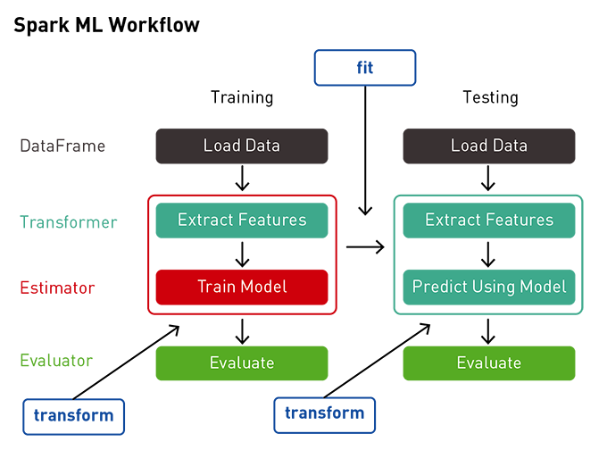
Model used: Gradient Boosting classifier with pipeline ML workflow
•Model Used: Gradient boosting classifier •We used pipeline from sklearn library to optimize the coding process and standardize workflow •This helped with preprocessing our data and transforming categorical data •Pipeline enables a sequence of data to be transformed and correlated in a model that can be tested and evaluated to achieve an outcome, this improves ”fit” •ML model created through the training process •The learning algorithm finds patterns in training the data that maps input data to the target (or outcome to be predicted) •Accuracy of this model was ~ .85

Slide 8
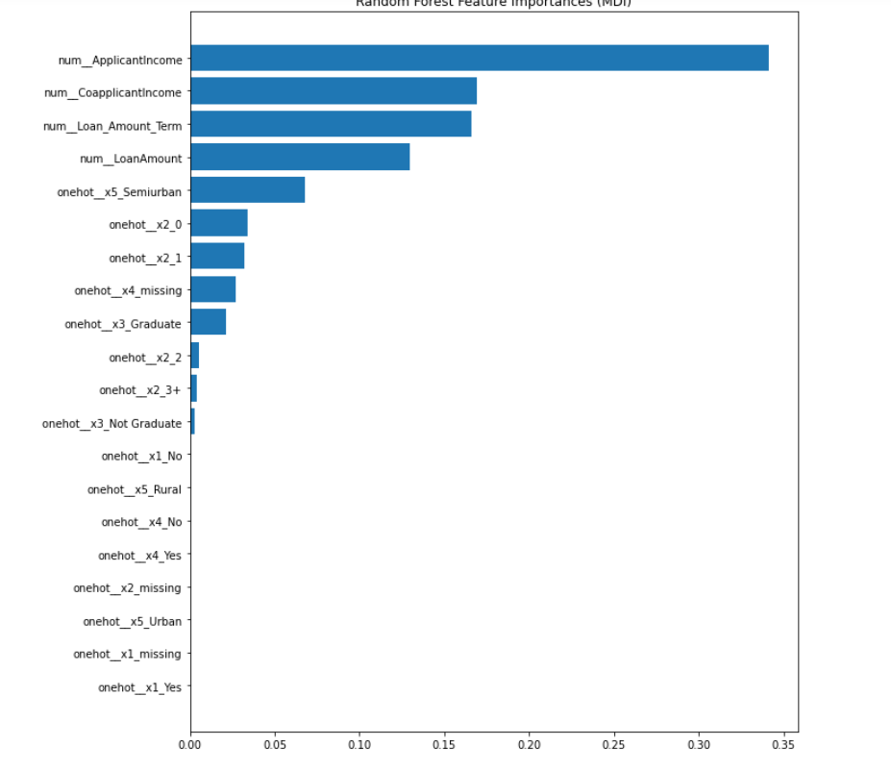
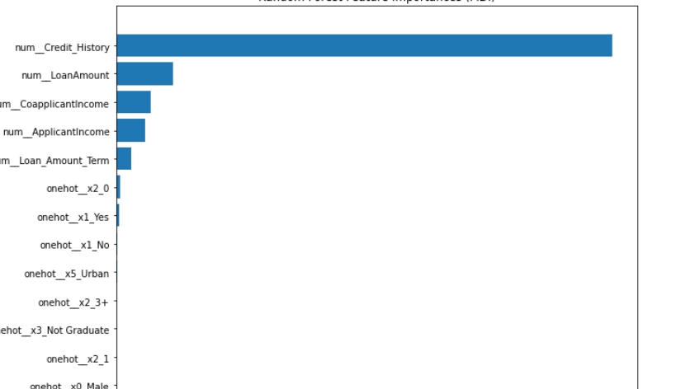
Featured factors in loan approval are credit history, loan amount, applicant and co-applicant income. When credit history is removed importance expands to suburban location and 2-3 dependants

Slide 9
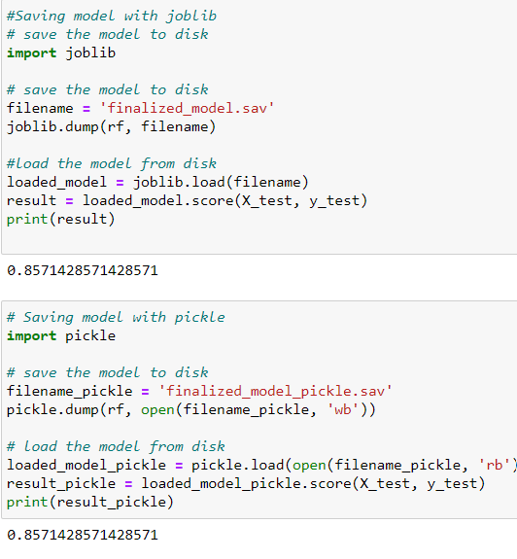
The model had an accuracy of .85

Slide 10
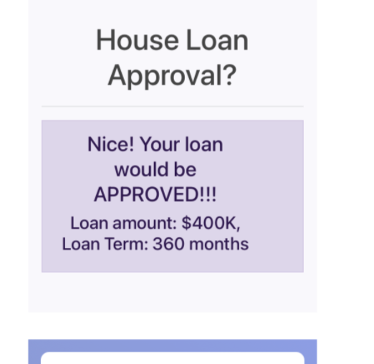
App hosted on Heroku

